Slide 1
API - LIFECYCLE MANAGEMENT
By: NagaTejaswi

Slide 2
3- Stages in API life cycle
Design
  Design: Analysing requirements, Creating logical data models etc.
  Simulate: API operations, resources, methods etc.
  Feedback: Publish and receive developers feedback.
  Validate: Update according to feedback.

Slide 3
Implementation
  Orchestration: Planning elements situation to produce desired effect.
  Routing: Message passing.
  Transformation: Converting application based message to canonical format and vice versa.
  Connectivity: Building API network.
  Testing

Slide 4
Management: Ensuring security and applying policies to our API.
  Secure
  Deploy
  Monitor
  Trouble shoot
  Manage

Slide 5
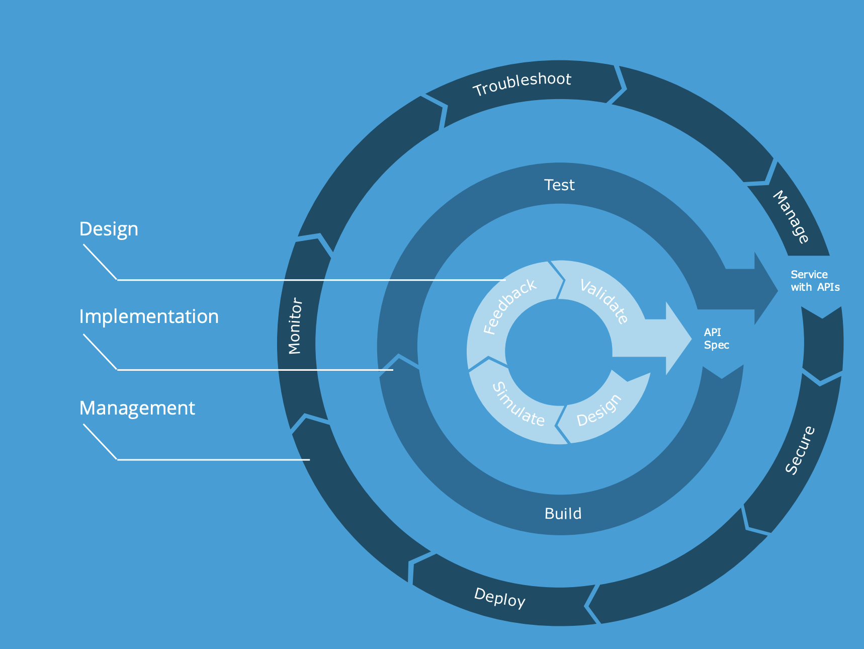

Slide 6
THANKYOU

